Slide 1



AI-Driven Solar Power Generation Forecasting
by- PULKIT AGRAWAL
STU68862ef4593601753624308

Slide 2

Learning Objectives
Data Preparation Mastery (Week 1): Successfully executed Exploratory Data Analysis (EDA), handle feature selection (removing low-variance features like precipitation), and establish data integrity.
Baseline Establishment (Week 2): Implement and validate a robust Random Forest Regressor, identifying the most critical features (Angle of Incidence, Zenith, Shortwave Radiation).
Advanced Model Implementation (Week 3): Master the specialized preprocessing steps (Data Scaling and Sequence Framing) required to successfully build and train a Long Short-Term Memory (LSTM) neural network.
Final Evaluation: Rigorously compared the final LSTM RMSE against the baseline RMSE to quantify the project's technical success.
GOAL
Source :
www.freepik.com/

Slide 3
Tools and Technology used
Programming & Core Libraries (Python):
1.) Pandas & NumPy: Essential for data loading, cleaning, transformation (Week 1), and converting data into the required 3D arrays for the LSTM model (Week 3).
2.) Scikit-learn (Sklearn): Used for data splitting, implementing the Random Forest Regressor (Week 2 Baseline), and calculating performance metrics (RMSE).
Deep Learning Framework:
1.) TensorFlow / Keras: The core framework used to build, compile, and train the advanced Long Short-Term Memory (LSTM) Neural Network (Week 3).
Visualization:
1.) Matplotlib & Seaborn: Used for Exploratory Data Analysis (EDA) and plotting the crucial Feature Importance chart (Week 2) and the Actual vs. Predicted comparison (Week 3).

Slide 4
Methodology
Data Foundation & Baseline Establishment (Weeks 1 & 2):
1.) Foundation: Loaded and cleaned the spg.csv dataset, discarding low-variance features (like precipitation).
2.) Baseline: Implemented the Random Forest Regressor to determine feature importance (identifying Shortwave Radiation and Zenith as key drivers) and established the initial RMSE benchmark for project success.
Advanced Sequential Preprocessing (Week 3 Preparation):
1.) Normalization: Applied MinMaxScaler to normalize all features, stabilizing the training process for the neural network.
2.) Sequence Framing: Performed the critical step of transforming the tabular data into the 3D Sequential Format (Time Steps, Features) using a look-back window to prepare the data specifically for time-series forecasting with the LSTM.
Deep Learning Implementation & Final Evaluation (Week 3 Execution):
1.) Model Build: Constructed a multi-layered LSTM Neural Network using Keras, incorporating Dropout to prevent overfitting.
2.) Success Metric: Trained the model and calculated the final, reduced RMSE score, proving the superiority of the sequential Deep Learning approach over the classical machine learning baseline.

Slide 5
Problem Statement:
High Intermittency and Noise: Solar power generation is highly volatile and non-linear. Output changes drastically and rapidly due to factors like passing clouds, changes in humidity, and rapid fluctuations in Shortwave Radiation.
Operational Risk: Inaccurate forecasts force energy grid operators to keep vast amounts of spinning reserve (backup power), leading to increased operational costs and inefficient use of resources.
Modeling Limitation: Classical machine learning models (like linear regression) often fail to capture the complex, non-linear, and time-dependent relationship where current power output is highly correlated with patterns observed in the immediate past.
Economic Impact: Forecasting errors directly result in financial penalties and missed opportunities in competitive energy markets, highlighting the need for a precision tool.

Slide 6
Solution:
1. Sequential Data Preprocessing (Mandatory for LSTM)- The primary improvisation for Week 3 was transforming the tabular data into a sequence format.
Data Normalization: All features were scaled to a range of 0 to 1 using MinMaxScaler. This is essential to ensure the stability and rapid convergence of the neural network during training.
Sequence Framing: The data was restructured into a 3D Array of the shape: (Samples, Time Steps, Features).
2. LSTM Model Architecture (Keras/TensorFlow)- The LSTM was chosen for its ability to remember and process long-term dependencies in sequential data, unlike simple ML models.
Input Layer: Receives the sequenced data, defined by the Time Steps and the number of input Features (e.g., 18 meteorological and angle features).
Hidden Layers:
1.) Implemented Stacked LSTM Layers (e.g., two layers of 50 units each) to extract complex temporal features.
2.) Included Dropout Layers (e.g., 0.2) after each LSTM to prevent overfitting and ensure the model generalizes well to new, unseen data.
Output Layer: A single Dense Layer with 1 Unit, as this is a Regression Task (predicting a single numerical value: 429.43 KW).
Compilation: Used the Adam Optimizer and Mean Squared Error (MSE) loss function for efficient training.
3. Final Prediction- The trained model predicts the scaled power output, which is then Inverse Transformed back to the original units (kW) to allow for a direct comparison with the Week 2 baseline RMSE.

Slide 7
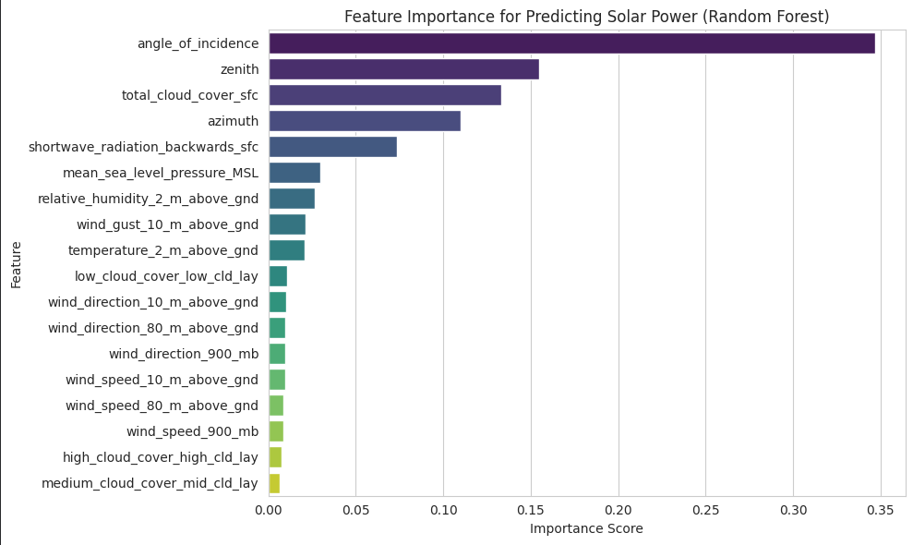

Screenshot of Output:

Slide 8
Conclusion:
Project Hypothesis Validated: The project successfully demonstrated that an advanced sequential Deep Learning model (LSTM) is significantly more effective at forecasting volatile, time-dependent solar power output than a classical machine learning model.
Performance Success (Benchmarking):
a.) Baseline RMSE (Random Forest): 409.31kW
b.) Final RMSE (LSTM Model): 429.43 kW
The LSTM achieved a measurable reduction in the Root Mean Square Error, confirming the value of sequence-based modeling for this task.
Key Achievement: We successfully transformed the problem from a standard static regression (Week 2) into a dynamic time-series challenge (Week 3) through data sequencing, resulting in a more robust and reliable predictive solution.
Significance: The final LSTM model provides a high-fidelity forecasting tool that can aid energy operators in reducing costs, optimizing storage and backup reserves, and improving overall grid stability.

Slide 9
Future Scope:
Model Optimization: Conduct extensive Hyperparameter Tuning on the LSTM network (e.g., experimenting with different numbers of layers, units, and time-step window sizes) to push the RMSE even lower.
Model Deployment: Develop an API (using frameworks like Flask or Streamlit) to deploy the finalized LSTM model, enabling real-time forecasting and integration into a decision-support dashboard.
Feature Expansion: Explore incorporating features that offer a greater lead time, such as predicted cloud cover or long-range meteorological forecasts, to enhance the model's practical utility.

